Slide 1

DATA ANALYTICS PROJECT · POWER BI
IT Support Dashboard
Analysis of 1,809 help desk tickets: from data cleaning to an
interactive dashboard with SLA and satisfaction KPIs.
Alberto · Data Analyst | Python · SQL · Power BI · Tableau

Slide 2



Context and goal
An IT help desk receives tickets from 8 business areas, but there was no visibility into volumes, SLA compliance, or user satisfaction.
Goal
Business questions
Tools
Build an executive Power BI dashboard that centralizes the state of the support operation.
Are we meeting SLAs? Which categories and areas generate the most tickets? How does volume evolve month over month?
Excel as the source, Power Query for cleaning, DAX for measures, and Power BI Desktop for visualization.

Slide 3

The dataset
An Excel file with 5 related tables — a typical help desk data model.
1,809
tickets logged (year 2025)
Tables in the model
17
columns per ticket
Tickets — facts: dates, SLA, satisfaction
Agents — team, seniority, and office
Areas — catalog of requesting areas
SLA_Priorities — target hours by priority
Categories — incident classification
12
agents across 3 offices
8
requesting business areas

Slide 4

Cleaning and shaping in Power Query
The raw data came with real quality issues that had to be solved before modeling:
Inconsistent text casing
Duplicate concept values
“conectividad”, “CONECTIVIDAD” and “Conectividad” appeared as different categories. Fixed with capitalization and Trim.
“Acceso y permisos” vs “Accesos y permisos”, “RRHH” vs “Recursos Humanos”, “Teams” vs “Microsoft Teams”. Unified with value replacement.
Meaningful nulls
Data types
Open tickets had no close date or resolution hours. They were kept and handled inside the DAX measures.
Dates and times stored as text; typed correctly to enable time intelligence and the monthly axis.

Slide 5


Data model and DAX measures
Star schema
1,809
342
The Tickets fact table relates to the Agents, Areas, Categories and SLA_Priorities dimensions through 1:N relationships, enabling the priority and agent slicers in the report.
Total Tickets
Open tickets
1,467
48.40 %
Calculated KPIs
Closed tickets
SLA compliance
Measures using CALCULATE, DIVIDE and AVERAGE to count tickets by status, compute the SLA compliance rate, and average user ratings.
3.66 / 5
Average rating

Slide 6
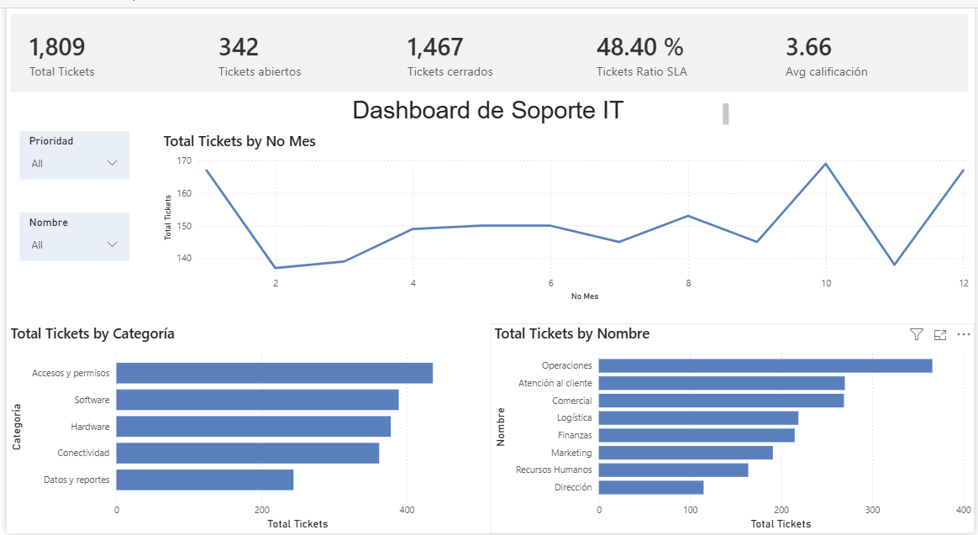
The dashboard
A single interactive page with slicers by priority and by agent.

Slide 7




Key insights
SLA compliance is the critical issue
Only 48.4% of closed tickets met their target time. Average resolution (62 h) often exceeds the 24–48 h targets for high and medium priorities.
Operations drives the demand
With 366 tickets it is the top requesting area, followed by Customer Service and Sales (269 each). Management has the lowest volume.
Four categories dominate
Software, Hardware, Connectivity, and Access & permissions generate ~80% of the volume; “Data & reports” is the smallest but has automation potential.
Satisfaction has room to improve
Average rating of 3.66/5. Monthly volume is stable (137–169 tickets), with peaks in January, October, and December.

Slide 8



Conclusions and next steps
The project covers the full analytics cycle: raw data → cleaning → modeling → KPIs → decisions.
Business recommendation
Report improvements
Next iterations
Prioritize a review of the resolution process: reinforce Level 1 support in high-volume categories to lift SLA compliance above 70%.
Add analysis by agent and office, a monthly SLA trend, and a tooltip comparing resolution hours vs. target.
Connect the source to a SQL database, schedule automatic refresh, and publish to the Power BI service.
Alberto — Data Analyst devlearnsal.github.io/Data-Analyst-Portfolio

